Slide 1
UNIT 7: THE MASS MEDIA
PART C: LISTENING

Slide 2
UNIT 7: THE MASS MEDIA
C: LISTENING
I. Before you listen
Work in pairs: Ask and answer the questions
1. How often do you listen to the radio?
2. How many hours per week do you listen to it?
3. What programme do you like listening to and why?

Slide 3
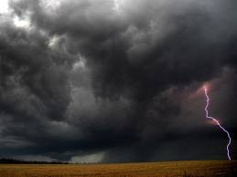
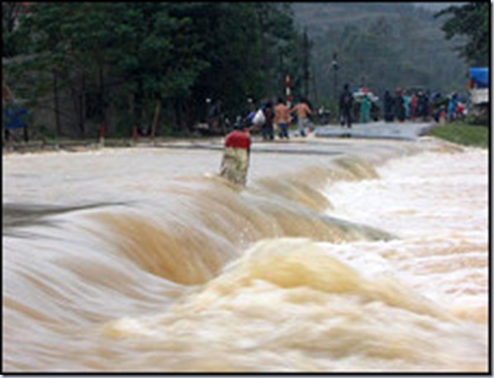
UNIT 7: THE MASS MEDIA
C: LISTENING
I. Before you listen
Vocabulary:
* cloudy (adj)
E.g: It looks cloudy. It is going to rain.
nhiều mây, u ám
* cause (v):
make something happen
gây ra
* flood (n)
lũ, lụt
* view (n)
E.g: I can see a nice view of the lake from the window.
tầm nhìn, quang cảnh
* rise (v) => (rose - risen)
move up
mọc (mặt trời)
dâng lên (nước sông),
E.g. The sun rises in the East.
E.g. Because of the flood, rivers have risen.

Slide 4
II. While you listen
Task 1: Listen to the two radio news stories and tick the words you hear in the right column under News story 1 and News story 2.
 | Adjectives | News story 1 | News story 2
1
2
3
4
5
6
healthy
strong
young
cloudy
highest
wonderful

Slide 5
II. While you listen
Task 1: Listen to the two radio news stories and tick the words you hear in the right column under News story 1 and News story 2.
 | Adjectives | News story 1 | News story 2
1
2
3
4
5
6
S1
S2
Others
Key
S1
S2
Others
Key
healthy

strong

young

cloudy

highest

wonderful


Slide 6
Task 2: Listen to the radio news stories again and fill in the missing words.
Heavy rain causes floods all over the country
Heavy rain during the night (1)…………… .. ….... all over the country today. Many people (2)…………………………because rivers (3)……………………Some roads in the north-west are under (4)…………….....of water. The rain (5) ………………..at the moment, but it’s still (6)…………and there’s a (7) ………….... Because of the bad weather, people can’t go out to work.
90-year-old American woman climbs Mount Whitney
A ninety-year-old woman has climbed Mount Whitney in California for the (1) ……………… time. At (2)………….. metres, Mount Whitney is the highest mountain in (3) ………………. The woman says the view from the top is (4) ………….., so she tries to climb it often. She also says that the mountain has kept her (5)…………….………...In spite of her old age, the woman tries to climb the mountain very often.

Slide 7
Task 2: Listen to the radio news stories again and fill in the missing words.
Heavy rain causes floods all over the country
Heavy rain during the night (1)…………… .. ….... all over the country today. Many people (2)…………………………because rivers (3)……………………Some roads in the north-west are under (4)…………….....of water. The rain (5) ………………..at the moment, but it’s still (6)…………and there’s a (7) ………….... Because of the bad weather, people can’t go out to work.
90-year-old American woman climbs Mount Whitney
A ninety-year-old woman has climbed Mount Whitney in California for the (1) ……………… time. At (2)………….. metres, Mount Whitney is the highest mountain in (3) ………………. The woman says the view from the top is (4) ………….., so she tries to climb it often. She also says that the mountain has kept her (5)…………….………...In spite of her old age, the woman tries to climb the mountain very often.

Slide 8
Task 2: Listen to the radio news stories again and fill in the missing words.
Heavy rain causes floods all over the country
Heavy rain during the night (1) has caused floods all over the country today. Many people (2) have left their homes because rivers (3) have risen. Some roads in the north-west are under (4) two meters of water. The rain (5) has stopped at the moment, but it’s still (6) cloudy and there’s a (7) strong wind Because of the bad weather, people can’t go out to work.
Heavy rain during the night (1) has caused floods all over
Heavy rain during the night (1) has caused floods all over
the country today.
the country today.
Many people (2) have left their homes
Many people (2) have left their homes
because rivers (3) have risen.
because rivers (3) have risen.
Some roads in the north-west
Some roads in the north-west
are under (4) two meters of water.
The rain (5) has stopped
are under (4) two meters of water.
The rain (5) has stopped
at the moment,
but it’s still (6) cloudy
and there’s a (7)
at the moment,
but it’s still (6) cloudy
and there’s a (7)
strong wind.
strong wind.
Because of the bad weather, people can’t go
out to work.

Slide 9
Task 2: Listen to the radio news stories again and fill in the missing words.
90-year-old American woman climbs Mount Whitney
A ninety-year-old woman has climbed Mount Whitney in California for the(1) twenty-third time. At(2) 4,418 metres, Mount Whitney is the highest mountain in (3) California. The woman says the view from the top is (4) wonderful, so she tries to climb it often. She also says that the mountain has kept her (5) young and healthy. In spite of her old age, the woman tries to climb the mountain very often.
A ninety-year-old woman has climbed Mount Whitney
A ninety-year-old woman has climbed Mount Whitney
At(2) 4,418 metres,
in California for the(1) twenty-third time.
At(2) 4,418 metres,
in California for the(1) twenty-third time.
Mount Whitney is the highest mountain in (3) California.
Mount Whitney is the highest mountain in (3) California.
The woman says the view from the top is (4) wonderful,
The woman says the view from the top is (4) wonderful,
so she tries to climb it often.
so she tries to climb it often.
She also says that the mountain
She also says that the mountain
has kept her (5) young and healthy.
In spite of her old age,
has kept her (5) young and healthy.
the woman tries to climb the mountain very often.

Slide 10
Task 3. Listen again and answer the following questions
1. What has happened during the night?
2. Why have people left their homes?
3. Is there a strong wind?
4. How many times has the old woman climbed Mount Whitney?
5. Is it the highest in California?
6. Why does she climb it so often?

Slide 11
00
Lucky number game
01
02
03
04
05
06
07
08
09
10
00
01
02
03
04
05
06
07
08
09
10
00
01
02
03
04
05
06
07
08
09
10
00
01
02
03
04
05
06
07
08
09
10
00
01
02
03
04
05
06
07
08
09
10
00
01
02
03
04
05
06
07
08
09
10
LUCKY NUMBER
LUCKY NUMBER
1
Why have people left their homes?
Because rivers have risen.
2
What has happened during the night?
Heavy rain has caused floods all over the country.
3
Yes, it is..
Is it the highest in California?
4
How many times has the old woman climbed Mount Whitney?
She has climbed Mount Whitney twenty three times.
5
Is there a strong wind?
Yes, there is.
6
Because it has kept her young and healthy.
Why does she climb it so often?

Slide 12
III. After you listen
Retell the news stories
*What has happened during the night?
*Why have people left their homes?
*How deep are some roads under the water?
*Is there a strong wind?
*How many times has the old woman climbed Mount Whitney?
* Is it the highest in California?
* What does she say about the view from the top?
* Why does she climb it so often?
Homework
- Rewrite the content of the 2 radio news stories.
- Prepare the next lesson: Unit 7: Writing

Slide 13
THANK YOU

